Slide 1
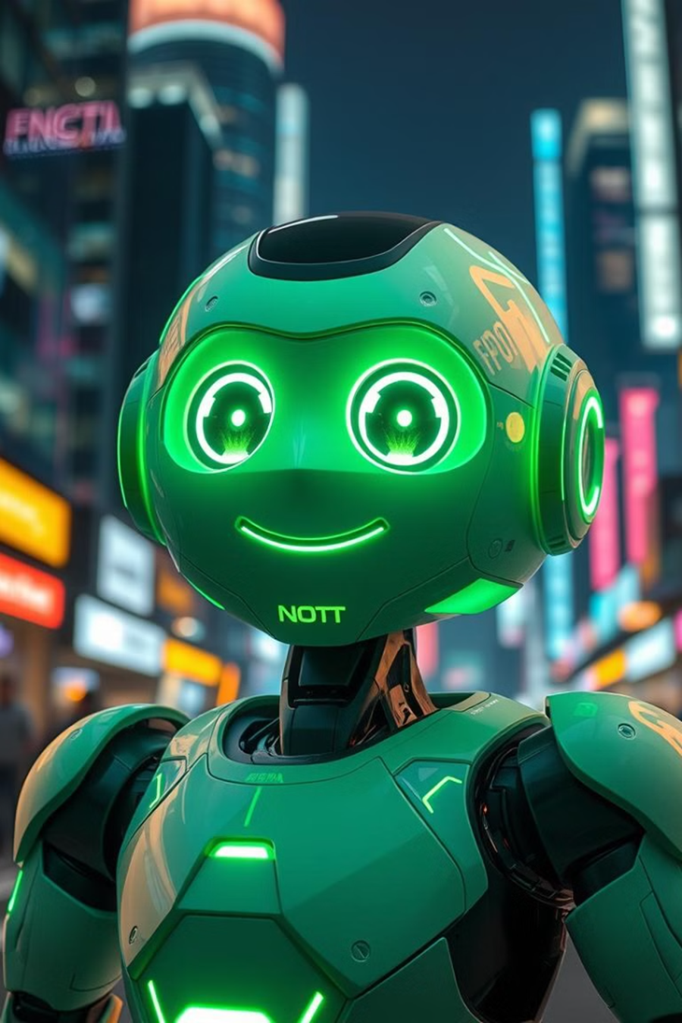


Developing an Intelligent Chatbot with virtual assistant
This presentation outlines a comprehensive approach to designing and developing an intelligent chatbot with virtual assistant capabilities. We will explore the key objectives, methodologies, timelines, and expected outcomes for this project, aiming to equip you with a clear understanding of the process and its essential components.
by Md. Mahfujul Karim and Arnesha Sarker Shithi

Slide 2
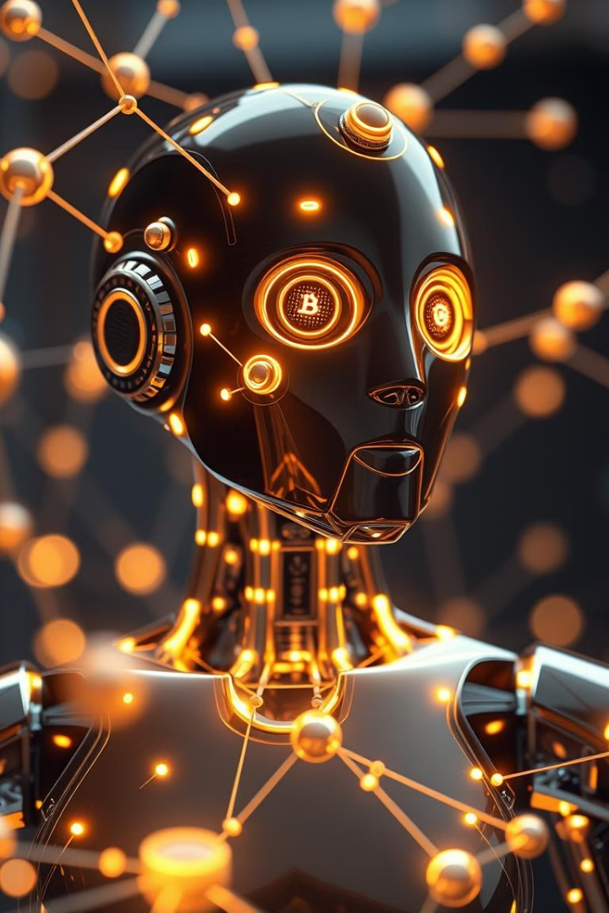
Project Objectives
1
Primary Objective
2
Specific Objectives
To design and develop an intelligent chatbot with virtual assistant capabilities that can interact with users in natural language and provide solutions to predefined tasks.
Integrate Natural Language Processing (NLP) techniques to understand user inputs. Implement machine learning algorithms to improve the chatbot’s responses over time. Provide a user-friendly interface that can be accessed via a web application or mobile app. Automate routine tasks such as customer support, FAQs, or personal reminders, depending on the chatbot's intended purpose. Improve user engagement through dynamic and personalized interactions.

Slide 3
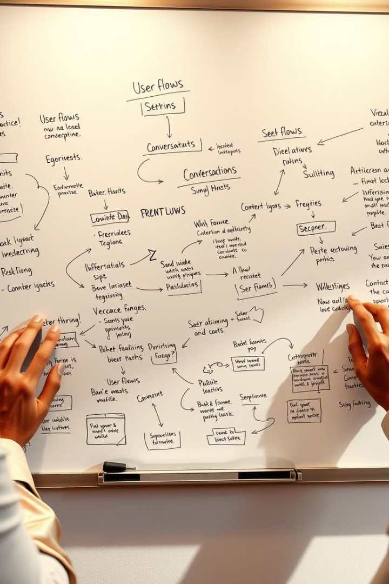
Methodology: Requirements Gathering and Design
1
Define Chatbot’s Purpose
Understand the target users and use case (e.g., customer service, virtual assistant, healthcare), ensuring the chatbot aligns with specific user needs and industry requirements.
2
User Flow Design
Create detailed conversational paths and workflows, mapping out anticipated user interactions and the bot's responses at each stage, considering potential questions, requests, and user intents.
3
Technology Stack Selection
Choose appropriate tools for NLP (e.g., Dialogflow, Rasa), programming languages (e.g., Python, JavaScript), and platforms for deployment (e.g., web app, mobile), considering project requirements and resource availability.

Slide 4
Development Phase
NLP Integration
Bot Framework Setup
Machine Learning
Utilize NLP libraries and APIs (e.g., spaCy, NLTK, or GPT) to process and interpret user input, enabling the chatbot to understand natural language and extract relevant information from user queries.
Leverage bot development platforms like Rasa or Dialogflow to build and train the bot, providing a framework for managing conversational flows, intents, and entities.
Apply machine learning techniques (e.g., supervised learning, reinforcement learning) to continuously improve the chatbot's responses based on user interactions, enabling it to learn from user feedback and provide more accurate and personalized answers over time.
Intent Recognition: Identify the user's goal or intent behind their query.
Entity Extraction: Extract specific entities (e.g., dates, names, locations) from user input.
Sentiment Analysis: Analyze the emotional tone or sentiment expressed by the user.

Slide 5
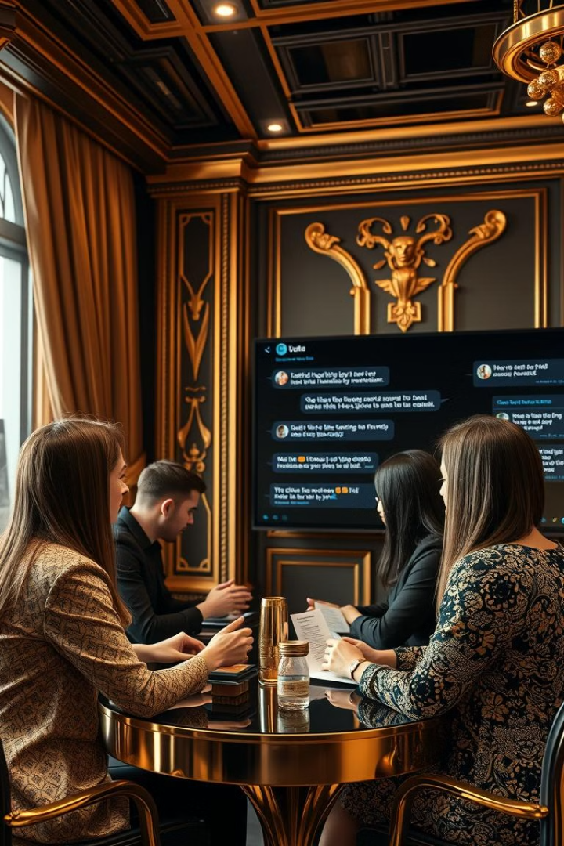



Testing and Refinement
Unit Testing
Conduct thorough unit tests to evaluate the functionality of individual components like NLP models, user input handling, and response generation, ensuring each component performs as intended.
User Testing
Perform usability testing with real users to assess the bot's effectiveness, intuitiveness, and user experience, gathering valuable feedback for improvements.
Feedback Loop
Integrate user feedback and testing results to refine the bot's behavior, accuracy, and user experience, ensuring its continuous improvement and alignment with user needs.

Slide 6
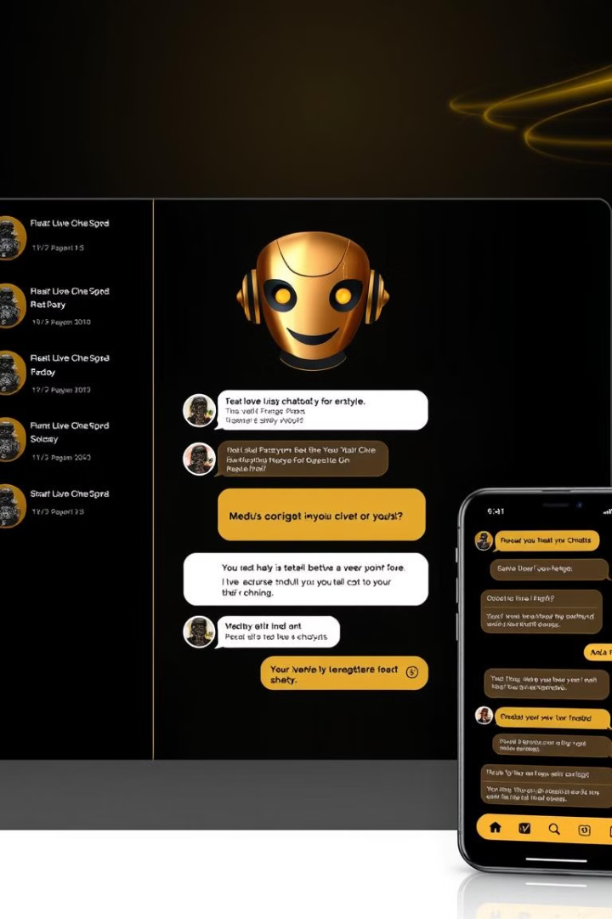
Deployment and Maintenance
Deployment
Monitoring & Updates
Deploy the chatbot on the chosen platform (e.g., website, mobile app, or messaging service), ensuring seamless integration and accessibility for target users.
Continuously monitor bot performance, analyzing user interactions, response accuracy, and overall user satisfaction, making necessary updates to its knowledge base, algorithms, and conversational flow based on gathered data.
Scalability
Design the architecture to accommodate increasing user volume and data demands, ensuring the chatbot can handle growing traffic and maintain consistent performance.

Slide 7
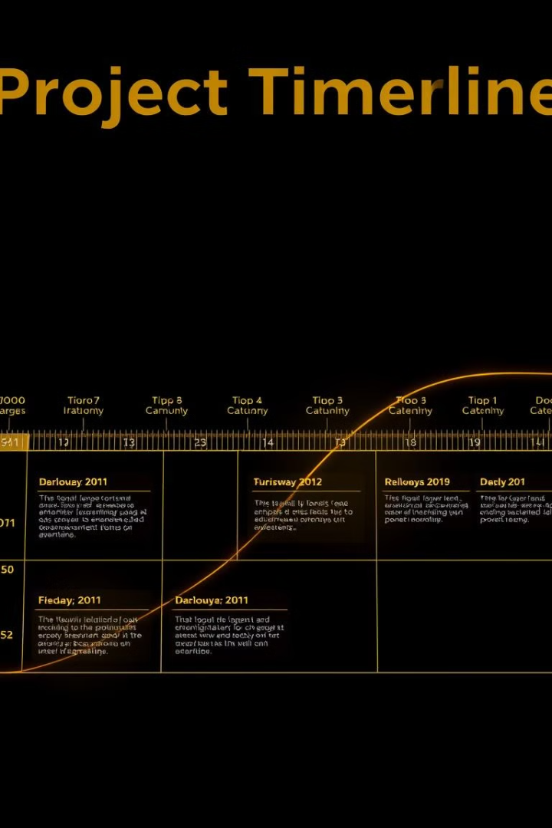
Timeline
Week 1-2
Project Planning and Design
Week 3-4
Setup and Tool Selection
Week 5-6
Development Phase 1 - Core Features
Week 7-8
Development Phase 2 - Machine Learning and Advanced Features
Week 9-10
Testing Phase
Week 11-12
Deployment and Final Refinements

Slide 8





Expected Outcomes
Functional Chatbot
Improved User Engagement
A fully developed chatbot capable of interacting with users and performing tasks (e.g., providing customer service, booking appointments, answering FAQs) in a natural and intuitive way.
An interface that users find engaging and easy to use, with personalized, context-aware responses, ensuring a positive and interactive experience.
Machine Learning Model
Deployed Solution
A continuously improving chatbot that learns from interactions to provide better responses, enhancing its accuracy and relevance over time.
A live chatbot on a website or mobile application that users can interact with in real time, making it readily accessible and usable.

